Slide 1
DETECTION OF COVID 19 FAKE NEWS
USING NATURAL LANGUAGE PROCESSING
BY ADAM , CLIFFORD AND MOSES

Slide 2
TABLE OF CONTENTS
INTRODUCTION
PURPOSE
LIMITATIONS
WHAT IS NLP
EDA
MODEL GENERATION
RESULTS
COMPARISON
CONCLUSION

Slide 3
INTRODUCTION
The outbreak of the novel coronavirus (COVID-19) has been accompanied by a large number of misleading and false information about the virus, especially through social media.
The same technology we rely on to stay informed, productive and connected is enabling and amplifying fake news that continue to undermine the global health response and jeopardizes measures to control the pandemic.
The spread of misleading information about the virus has led the World Health Organization to warn of an on-going “infodemic” or an overabundance of information,both online and offline.

Slide 4
PURPOSE
This project aims to develop a method for detecting and classifying COVID-19 fake news stories using Natural Language Processing.
The main goal is to identify COVID-19 Fake news, which is a text classification problem.
We gathered data,preprocessed the text, and translated news articles into supervised model features.
Our goal is to develop a model that classifies a given article or social media post as either fake or true.

Slide 5
LIMITATIONS
Our system does not guarantee 100% accuracy
The system is unable to test data that is unrelated to the training dataset.

Slide 6
WHAT IS NATURAL LANGUAGE PROCESSING (NLP)
NLP) is a branch of machine learning that deals with processing, analyzing, and sometimes generating human speech (“natural language”).
There’s no doubt that humans are still much better than machines at determining the meaning of a string of text.
However in data science, we often encounter data sets that are far too large to be analyzed by a human in a reasonable amount of time.
In these situations, we can use natural language processing techniques to help machines get some understanding of the text’s meaning (and if necessary, respond accordingly).

Slide 7

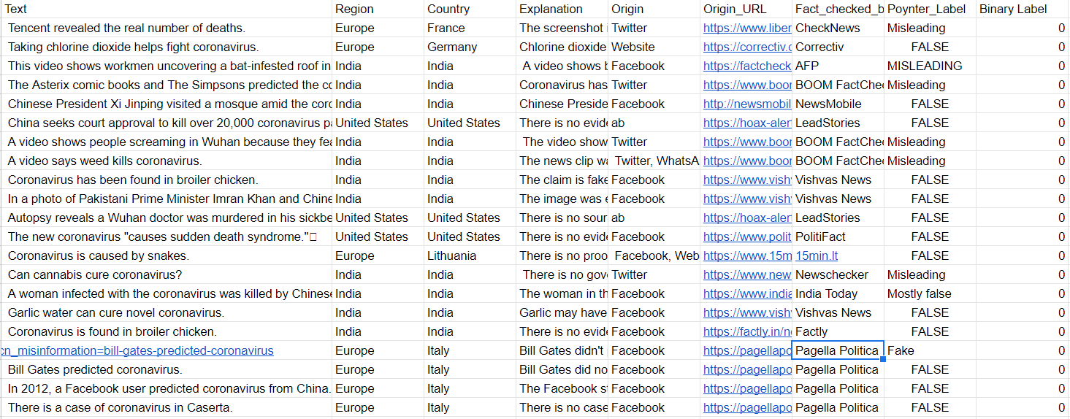
OUR DATA
Our original data set consisted of two csv files containing fake and true News.
— source : ieee.org

Slide 8
EDA
01
Exploratory Data Analysis

Slide 9
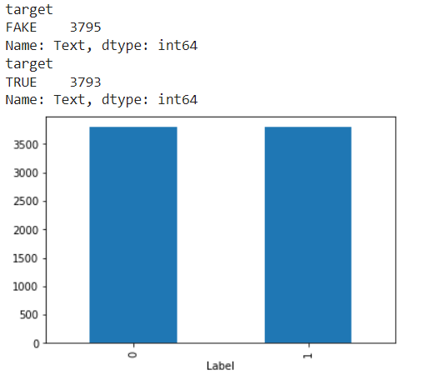
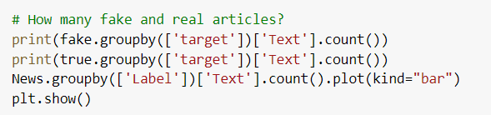

Slide 10
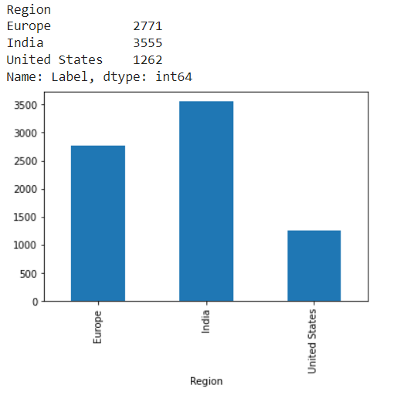
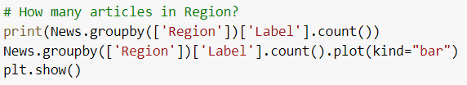

Slide 11
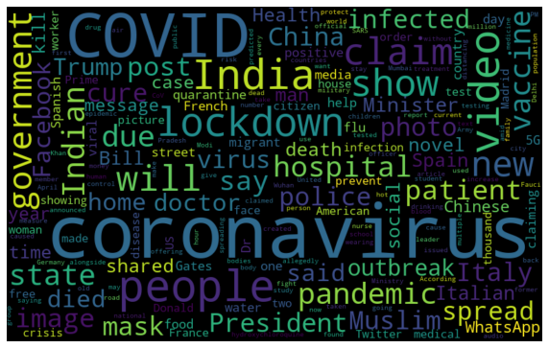
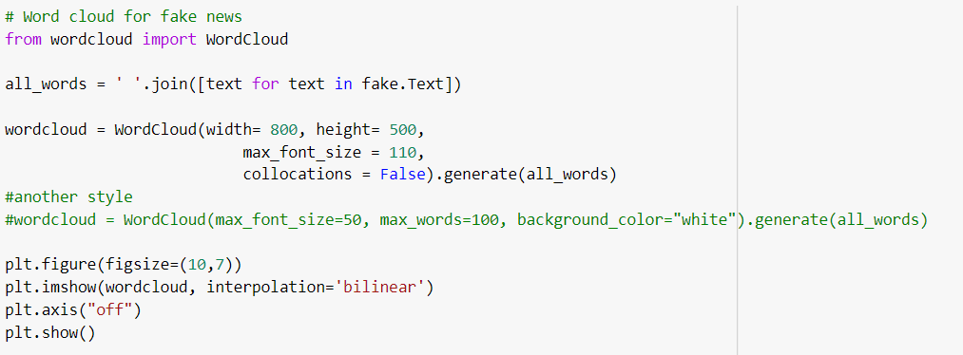

Slide 12
TEXT CLASSIFICATION USING SPACY
First, we extract the features we want from our source text (and any tags or metadata it came with), and then we feed our cleaned data into a machine learning algorithm that does the classification for us.
TEXT
FEATURE EXTRACTION
FEATURES
MACHINE LEARNING
ALGORITHM
TEXT
CLASSIFICATION
TAG

Slide 13
Analyzing and Processing Text With spaCy
Tokenization - breaking text into pieces, called tokens, and ignoring characters like punctuation marks.
Removing of stopwords
Perform checks for spelling mistakes.
Pos Tagging - identifies parts of speech e.g nouns,verbs etc.
Entity Detection -identifies important elements like places, people, organizations

Slide 14
RESULTS
 | ACCURACY | PRECISION | RECALL
LOGISTIC REGRESSION | 93.94 | 92.36 | 95.37
RANDOM FOREST | 94.01 | 92.59 | 95.24
DECISION TREE | 89.20 | 83.87 | 96.19

Slide 15
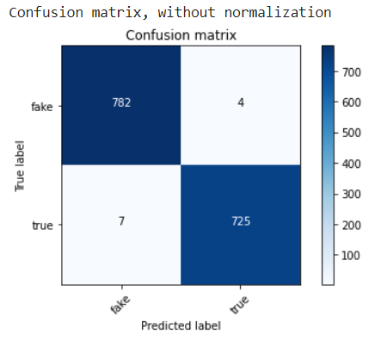
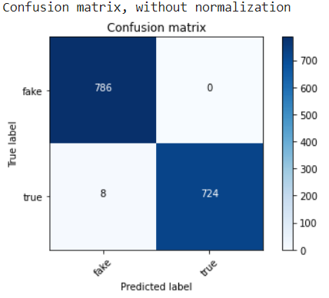
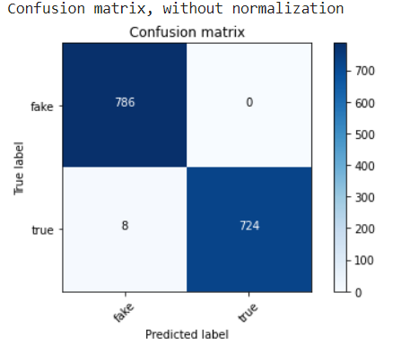
COMPARISONS
Logistic Regression
Random Forest
DecisionTree
Despite being red, Mars is actually a cold place

Slide 16

“ NEVER STOP LEARNING BECAUSE LIFE NEVER STOPS TEACHING ”

Slide 17
THE END!

